Slide 1

Database Schema:
The Ghost of Experiments Yet-To-Come
Accommodating Additional
Experiment Types
and
Data Growth
in ISPyB

Slide 2
Problems
Terminology from MX & life science
Table structure:
  MX bias
  Not designed for high data rates & volumes
➱ For increased adoption of ISPyB, schema must make sense beyond MX & life science
  new beamlines / instruments
  new synchrotrons / facilities
Notes:
We need to look beyond the requirements of our own synchrotrons!

Slide 3


More generic or more specific?
Special tables vs making tables more generic?
Experience from incorporating BioSAXS, XPDF, EM:
  Special tables are sometimes needed
  A lot of tables can still be shared
  Sharing advantages:
    less API work
    less complexity
    stats and comparisons across all beamlines / instruments
➱ Strive towards universal tables when sensible
Notes:
Rainbows vs Snowflakes!

Slide 4
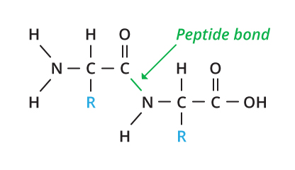
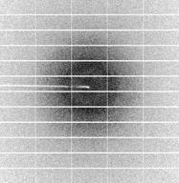
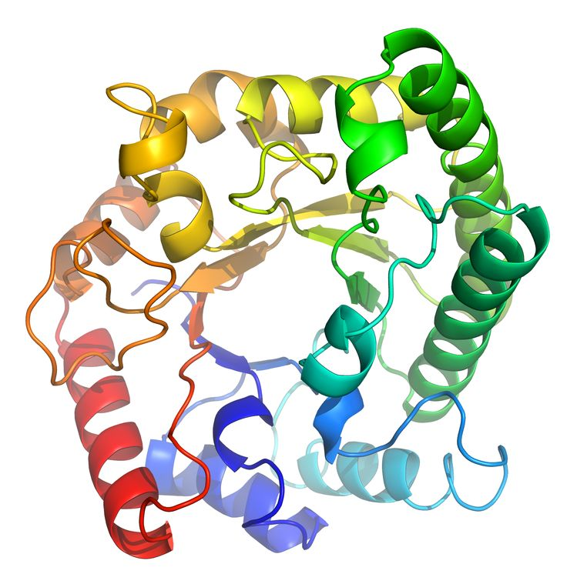
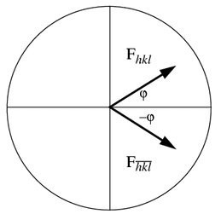
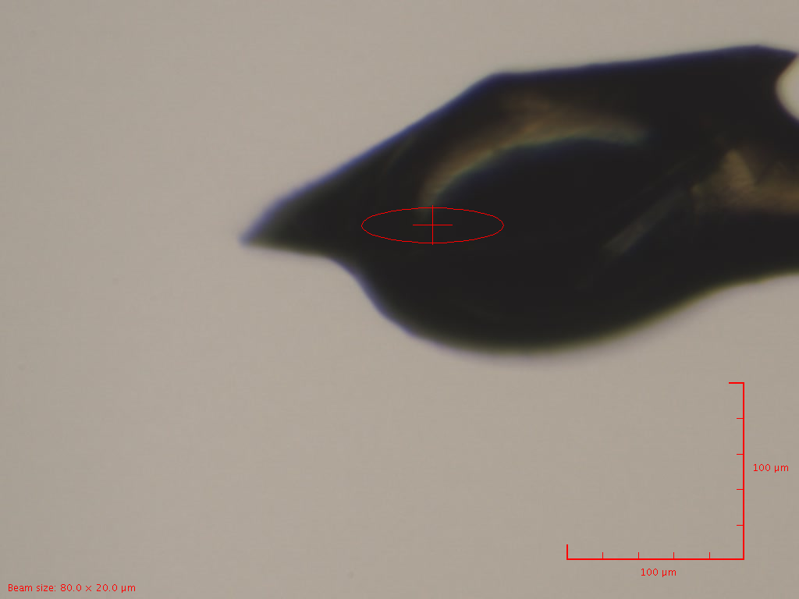
Main Terminology Issues
Protein ➞ Component
  Protein.sequence ➞ Component.content
Crystal ➞ BLSampleType
DiffractionPlan ➞ DataCollectionPlan
See issue #42.

Slide 5
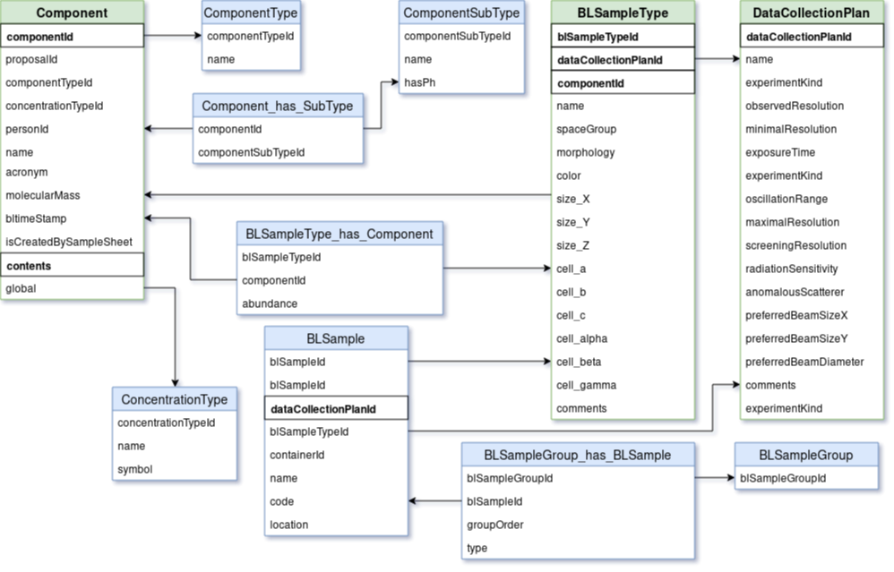

Slide 6
BLSample Relationships - MX Bias
Samples must belong to a session or proposal
Some phys. beamlines have no containers, just samples: Bone, Martian meteorite, metal, ...
➱ Option 1: Denormalisation - add BLSample.sessionId
➱ Option 2: Default Container - Container.sessionId

Slide 7
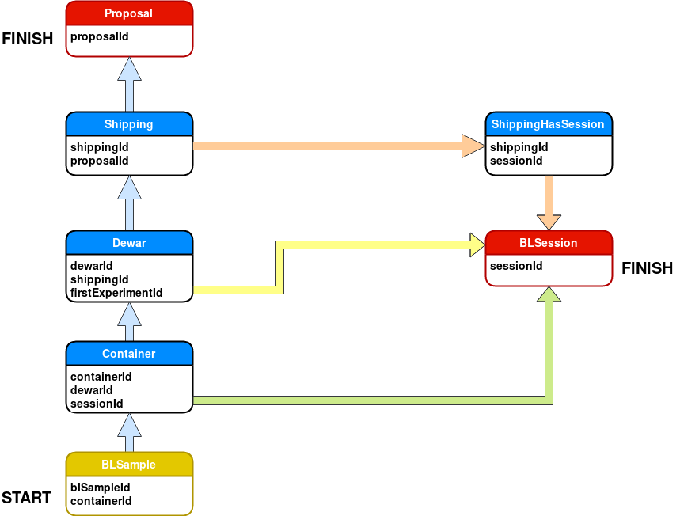

Slide 8
DataCollection
Similar columns in:
  EnergyScan
  XFEFluorescenceSpectrum
numberOfImages, startImageNumber, imageDirectory, imagePrefix, imageSuffix, imageContainerSubPath
  scan and scanPoint?
  frame?
  measurement?
  data and dataPoint?
Too many varchar(255) columns?
Use a BLSession.rootPath column? (Issue #25)
xtalSnapshotFullPath1..4 -> use D.C.FileAttachment?

Slide 9
ImageQualityIndicators: Problems
MX specific
Even the name - how about ‘DataQualityIndicators’?
Unused and unnecessary columns
autoProcProgramId is not nullable
Table will grow huge over time leading to slower queries and larger, slower backup and longer restore time
Need to be able to insert data faster
See issue #24.

Slide 10
Removed: imageQualityIndicatorsId
+-------------------------+--------------------+------+-----+---------+-------+
| Field | Type | Null | Key | Default | Extra |
+-------------------------+--------------------+------+-----+---------+-------+
| dataCollectionId | int(11) unsigned | NO | PRI | NULL | |
| imageNumber | mediumint(8) unsigne| NO | PRI | NULL | |
| imageId | int(12) | YES | | NULL | |
| autoProcProgramId | int(10) unsigned | YES | | NULL | |
| spotTotal | int(10) | YES | | NULL | |
| inResTotal | int(10) | YES | | NULL | |
| goodBraggCandidates | int(10) | YES | | NULL | |
| iceRings | int(10) | YES | | NULL | |
| method1Res | float | YES | | NULL | |
| method2Res | float | YES | | NULL | |
| maxUnitCell | float | YES | | NULL | |
| pctSaturationTop50Peaks | float | YES | | NULL | |
| inResolutionOvrlSpots | int(10) | YES | | NULL | |
| binPopCutOffMethod2Res | float | YES | | NULL | |
| recordTimeStamp | datetime | YES | | NULL | |
| totalIntegratedSignal | double | YES | | NULL | |
| dozor_score | double | YES | | NULL | |
| driftFactor | float | YES | | NULL | |
+-------------------------+-----------------------+------+-----+---------+-------+

Slide 11
ImageQualityIndicators: To do
Remove unnecessary columns?
in_res_total: always set to same value as spots_total
method2_res: always same value as method1_res
autoProcProgramid: always 65228265
icerings: always 0
maxunitcell: always 0
pctsaturationtop50peaks: always 0
inresolutionovrlspots: always 0
binpopcutoffmethod2res: always 0

Slide 12
Processing tables
Most processing tables are MX specific
Complex structure
‘AutoProc’ - also used for manual processing
Can the table structure be made simpler and more flexible?
Can the tables be made more universal?
Unstructured data: JSON datatype?

Slide 13
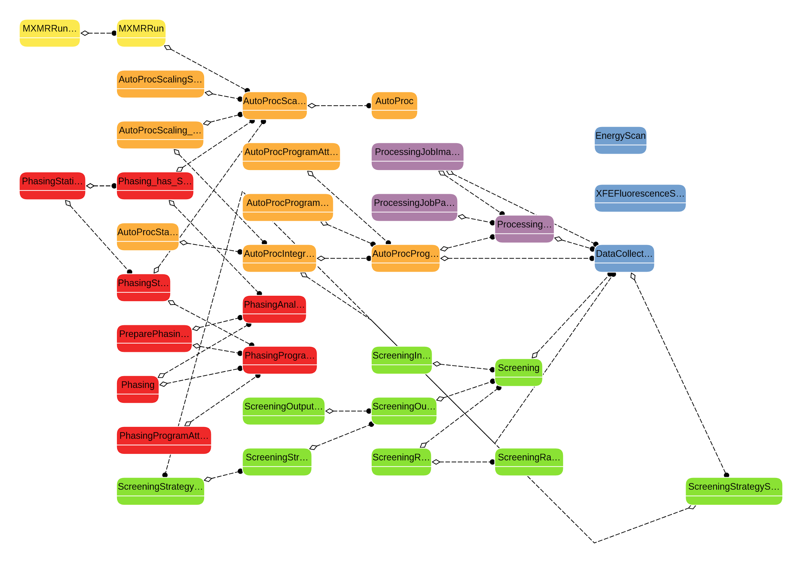

Slide 14
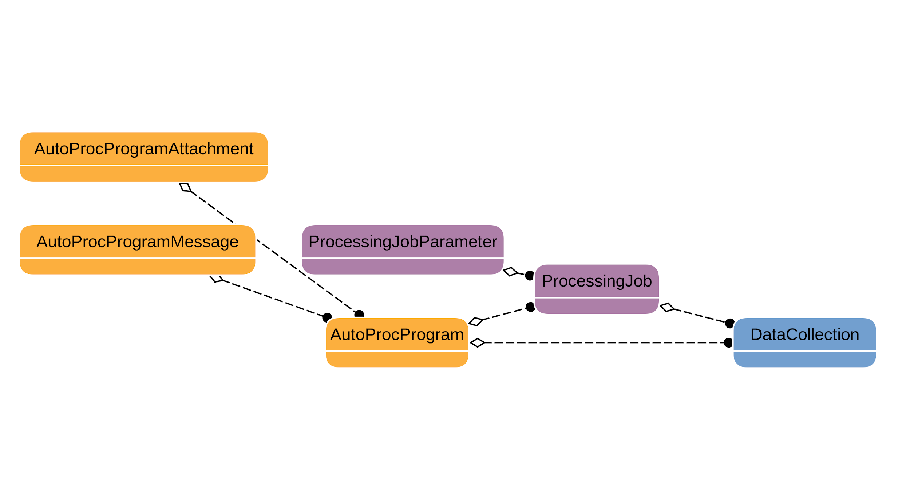

Slide 15
Database changes mean downtime?
Not necessarily for the database …!

Slide 16
Online Schema Change
Built-in features: ALTER TABLE in MariaDB & MySQL:
  ALGORITHM=INPLACE (10.0, 8.0)
  ALGORITHM=NOCOPY (10.3, 8.0)
  ALGORITHM=INSTANT (10.3, 8.0)
  Instant ADD COLUMN (10.3, 8.0)
  Instant DROP COLUMN (10.4)
  Instant column re-ordering (10.4)
  More: default values, enums etc.
pt-online-schema-change in Percona Tools
  NB! Doesn’t seem to work with MariaDB 10.3
gh-ost: Github’s online schema transmogrifier

Slide 17
Summary - proposed changes
Rename protein, sequence, crystal, diffraction plan
Container-less samples - as is, no changes
DataCollection: rename ‘image’ columns to:
  numberOfDataPoints and
startDataPointNumber
  dataDirectory
  filePrefix and fileSuffix (because fileTemplate)
  dataContainerSubPath
DataCollection: remove xtalSnapShotFullPath1..4
ImageQualityIndicators: rename, remove unnecessary
Processing tables: Rename AutoProc* to Proc*

Slide 18
Thank you!

